Slide 1

TL 1 Presentation
Carson Gustavel
Michael Habermann
Ferris Hammes-Buehler
Nathan Hampton
Kenny Kline
Ian McCall
Ashton Pomerantz
Nate Summers

Slide 2
What is a Storyboard?
A storyboard is a visual representation that helps with digital storytelling.
Storyboards are broken down into panels like a comic book.
A storyboard is a guide of how your game is going to look before you actually create it.
They can also include technical aspects to explain design.
Ashton

Slide 3
What can a Storyboard Capture?
What characters are in frame - how are they moving?
What are the characters saying to each other?
How much time has passed between frames?
Where is the camera?
Close or far?
Is it moving?
Ashton

Slide 4
Why Storyboards?
Storyboards help you plan your game out shot by shot
You can alter a storyboard before you start animating, instead of going back and changing your mind later.
They create a visual aid for talking about your game to share it with others and get feedback on your ideas.
Ashton

Slide 5
Beat Board vs Storyboard
A beat board is similar to a storyboard but less detailed.
It shows the idea in no more than 16 images.
It lacks the additional details of shot type, camera angle, speech, etc.
Perfect for a short pitch to get your general idea across.
Ashton

Slide 6

Your Storyboard
Somewhere between a storyboard and a beat board
Action:
Dialog:
Notes:
Ashton

Slide 7

Very Brief Example
Dialog:
Oracle: To win this game you must build a boat and cross the ocean to the land of Cees. It will be a perilous journey.
Start by cutting down trees for your boat
Ashton

Slide 8

Very Brief Example
Action:
Player cuts down 15 trees and assembles a boat.
Ashton

Slide 9

Very Brief Example
Action:
Sea monster attacks boat.
Player dodges fireballs until sea monster is out of breath.
Ashton

Slide 10

Very Brief Example
Action:
Player unlocks vault and gets trophy.
The end.
Ashton

Slide 11
Systems Analysis
Michael
See https://webpages.uidaho.edu/drbc/cs383/assignments/04b_PresentationMarkingKey.pdf for a list of what needs to be presented.

Slide 12

Setting up a Git Repo - Github.com
Carson G

Slide 13
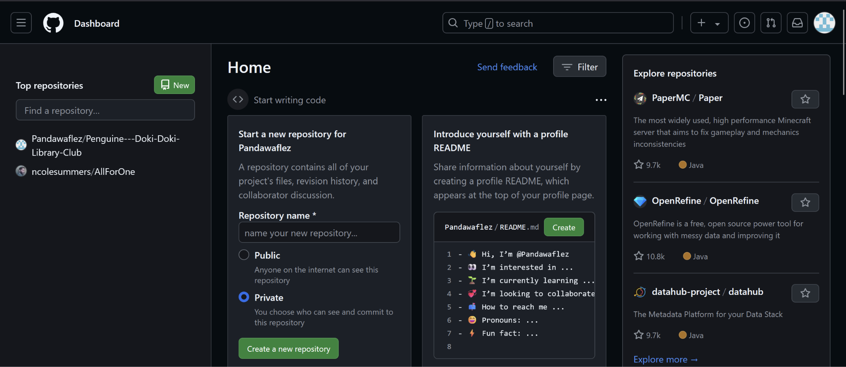
Once you’re logged in…

Slide 14
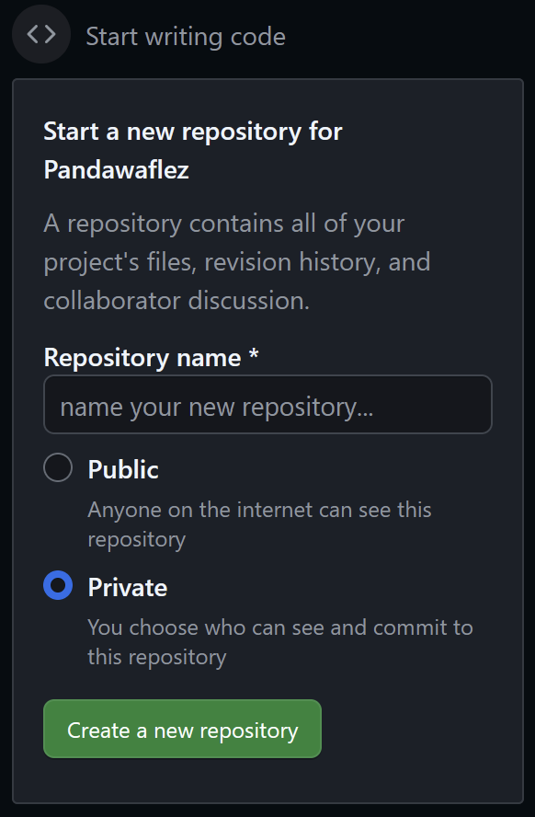
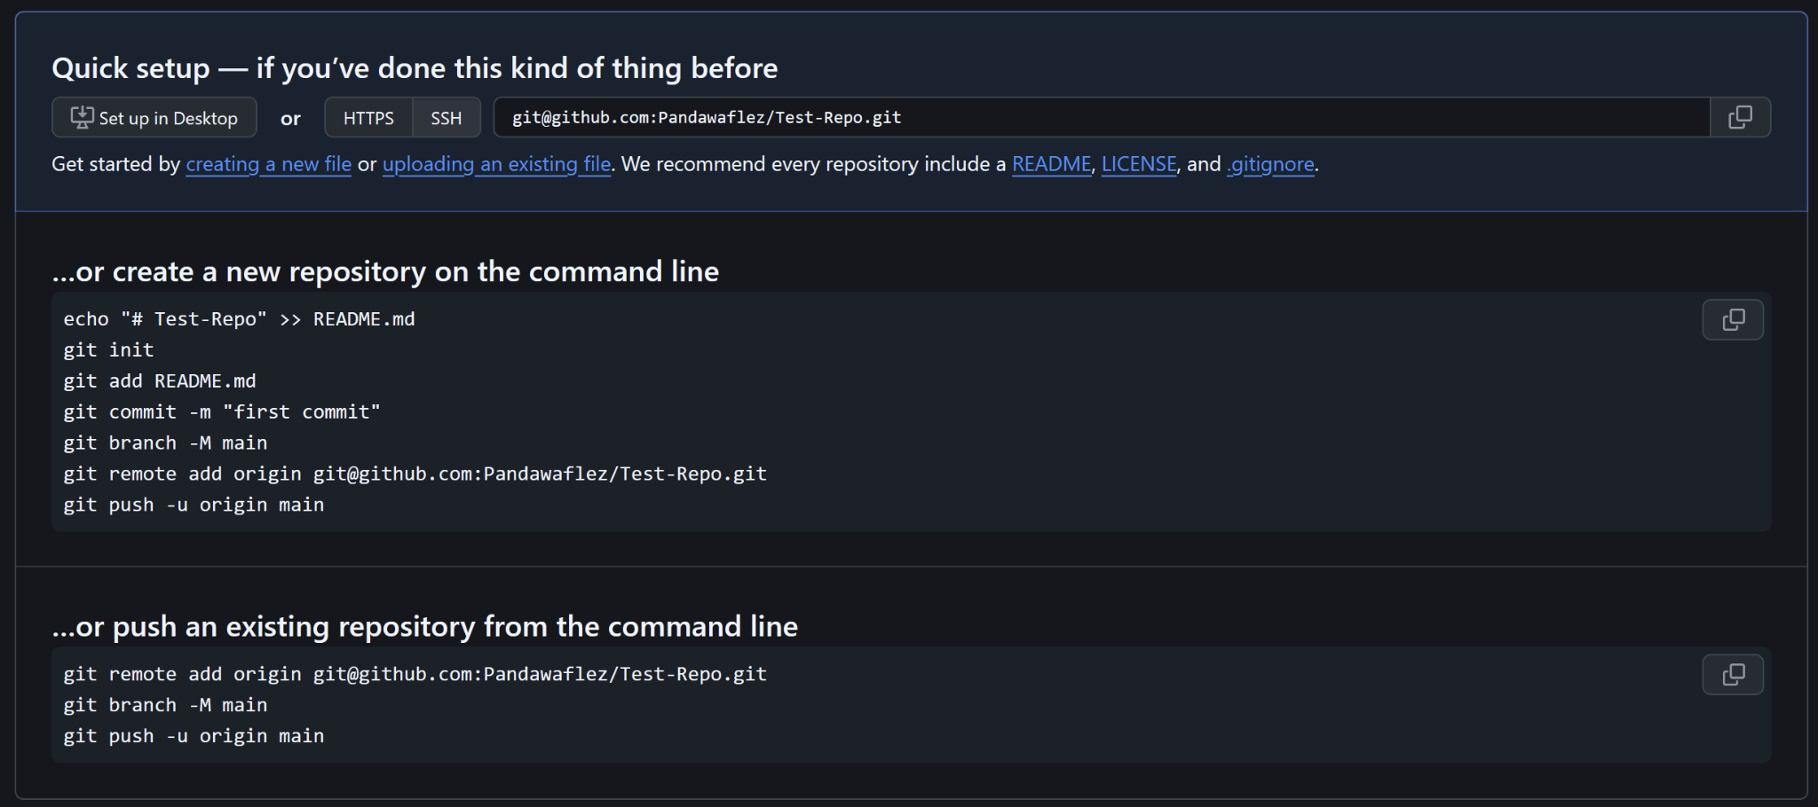

Slide 15
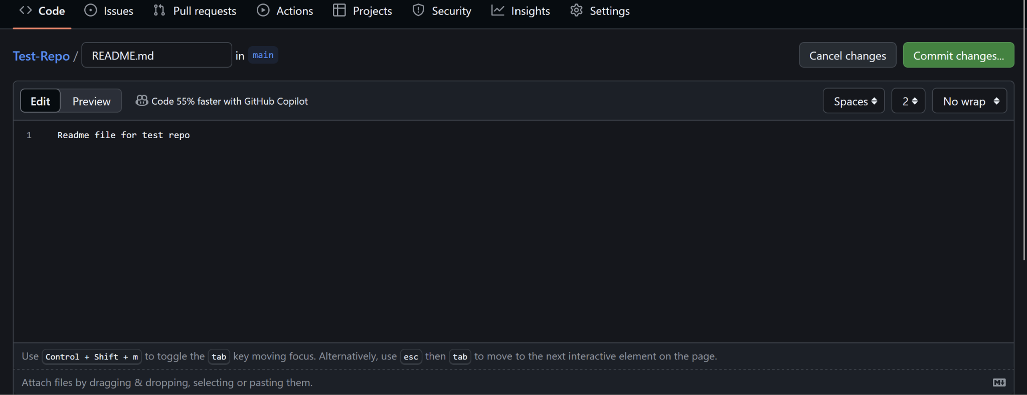

Slide 16
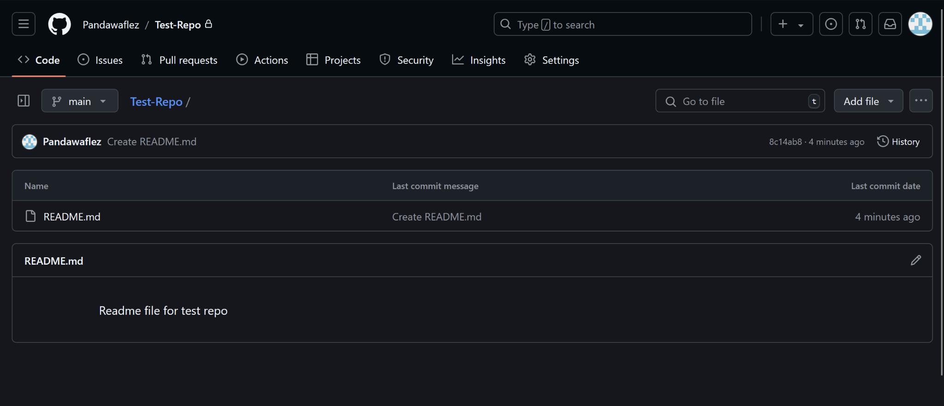

Slide 17
Downloading ways to use Git
Git comes preloaded onto most linux machines (including WSL Ubuntu Terminal) and most Mac terminals as well.
https://git-scm.com/downloads - Git Bash
https://desktop.github.com/download/ - Github Desktop

Slide 18
Adding a .gitignore
Ferris
Explain what .gitignore does, why it’s useful, and how to set one up.

Slide 19

Adding a .gitignore
Ferris Hammes-Buehler

Slide 20
.gitignore
What is a .gitignore file?
Ferris Hammes-Buehler
Notes:
.gitignore is a very powerful tool, especially when managing large numbers of files in a repository.
.gitignore describes a number of patterns to the git manager, so that when pushing files to the repo, unnecessary files are not pushed. For example, a temporary file created when compiling code would be unnecessary to push to the repository.

Slide 21
Copying from a template
github.com/github/gitignore
./Unity.gitignore
./UnrealEngine.gitignore
./VisualStudio.gitignore
./Godot.gitignore
./Julia.gitignore
Ferris Hammes-Buehler
Notes:
Github has a number of template files that you are more than welcome to use! you can find them by searching “gitignore template” or following this link. You can also choose from that list of templates when you set up your repository.
Some useful templates, depending on what we’re working in, might be Unity.gitignore, UnrealEngine.gitignore, VisualStudio.gitignore, Godot.gitignore, or if you’re in my team, you can use this one that’s in there to ignore my Team Lead 6’s work entirely!

Slide 22
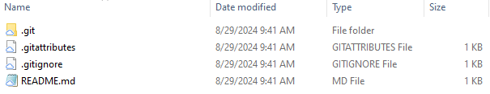
Copying from a template
Ferris Hammes-Buehler
Notes:
To use a templated .gitignore, make sure that it’s in the root file of your repository.

Slide 23
Creating your own .gitignore
* - Any number of any characters
? - Any single character
[aA] - a or A
[a-z] - a through z
! - Exception character
/[fF]erris/[aA]ssets/
!/[fF]erris/[aA]ssets/tileMap.png
Ferris Hammes-Buehler
Notes:
I highly recommend that you use a template, but if you want to modify it or create your own, you can use some special characters to designate files or folders to leave out of the push.
Asterisk - Wildcard
characters in brackets - or statement
for example, if we want to ignore the assets folder in my directory, but we don’t know how I’ve capitalized my folder(s), we can use this string to ignore that folder. However! Perhaps I have a tile pattern in that folder that I want to keep. We can use this string to maintain that file, which overrides the earlier pattern as long as it’s put after.
Does anyone have any questions?

Slide 24
Github Limitation
Limits of git providers (like github)
File size limits of 100 MiB
Working with video games you might encounter
High Definition Assets
Binary Exports
Large Texture map
Nathan Hampton

Slide 25
The Solution
Git Large File Storage (LFS)
Maintains large files locally
Treats everything else as normal
Replaces large files with a “pointer” to other remote
Still allows version control of large files
Nathan Hampton

Slide 26
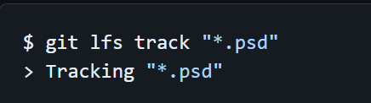
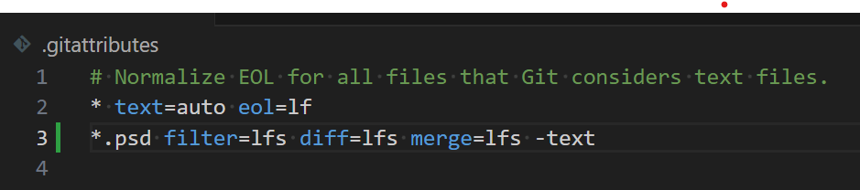
Large File Storage (GitLFS)
How it Works:
Nathan Hampton

Slide 27
LFS Limits
Github Free Tier
1 GiB of free storage and 1 GiB a month of free bandwidth
Nathan Hampton

Slide 28
Git Basics
push - uploading all the data from your computer to github for others to see/use
pull - downloading the latest version of the project from github with all the changes your teammates have made
branch - creating a separate version of the project with only the changes related to a particular feature
merge - combining two branches to have all the changes made in both of them
Kenny Kline

Slide 29
Git Basics
commit - a set of changes to the project (ie, new function) which git will treat as a single unit
add - adding your changes is telling git that you are about to commit them
status - helpful git command which will tell you the current state of your local git repo
clone - similar to pull, but will create an entirely new copy of the github repo rather than updating one you already have
Kenny Kline

Slide 30
Git Basics - Demo
Kenny Kline

Slide 31

GitHub Desktop: The Basics
Search for Github Desktop on your browser and download
Comes with GIT pre built in the application
The first thing to do is clone a repository
Ian McCall

Slide 32
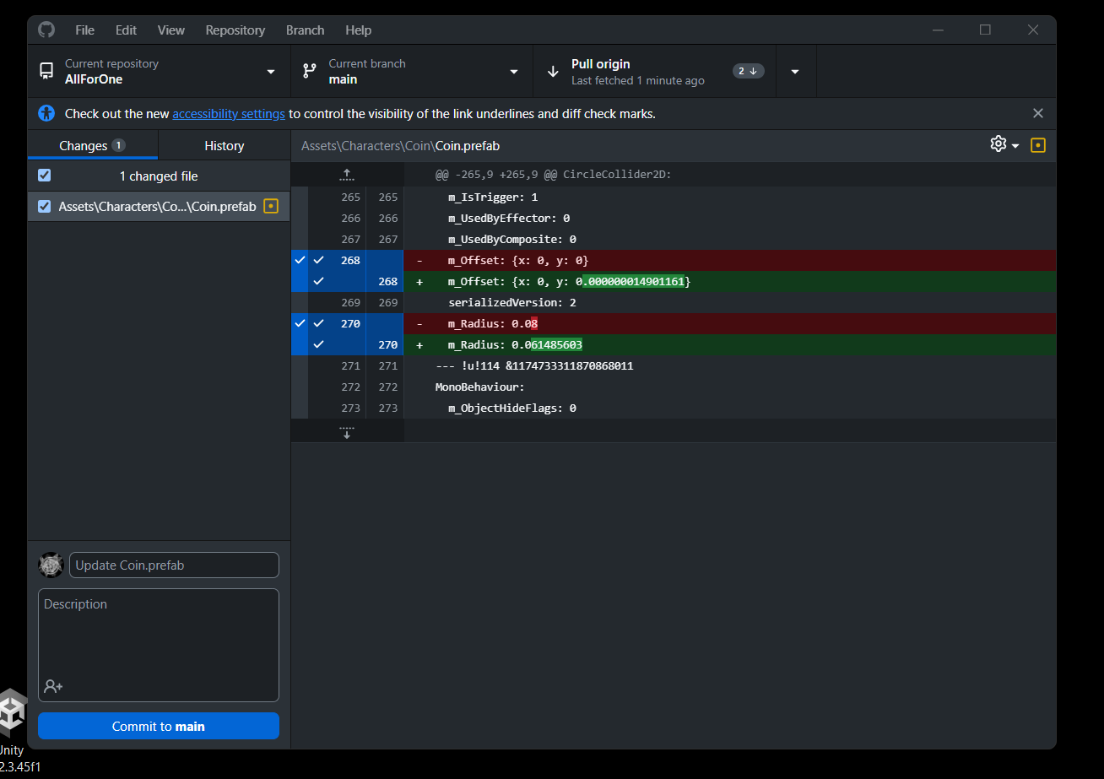
Clone the Repository
Ian McCall

Slide 33
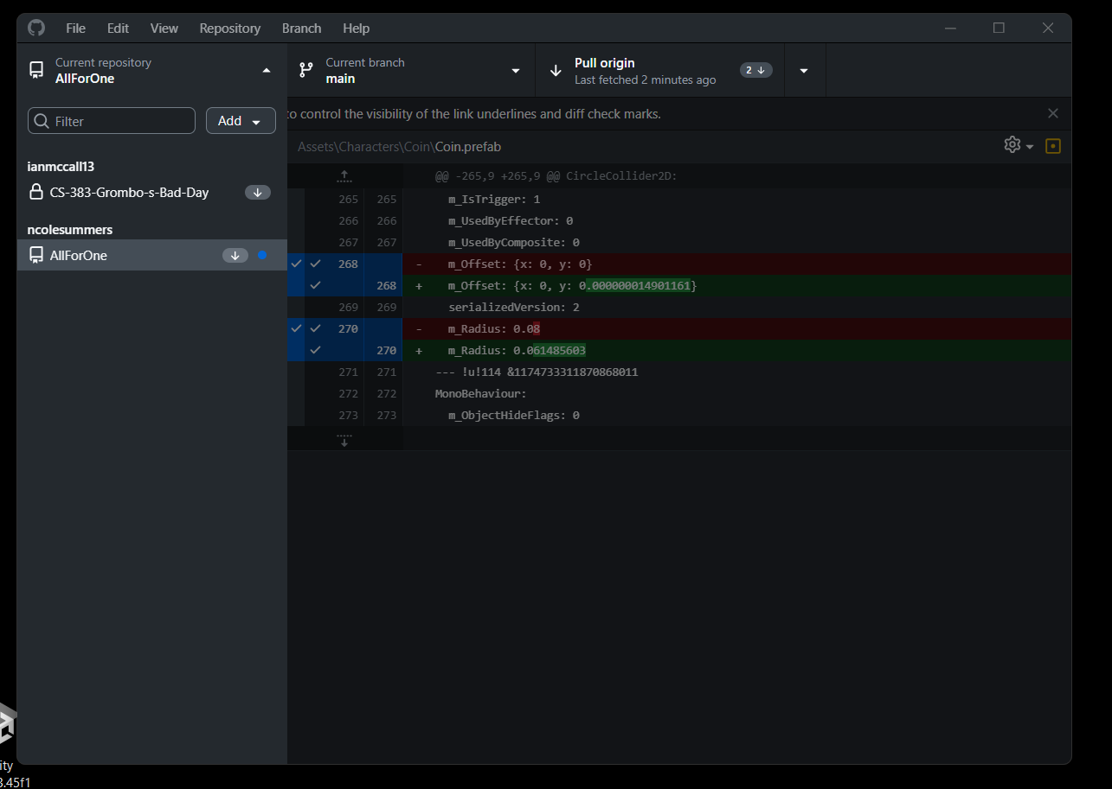
Clone the Repository
Ian McCall

Slide 34
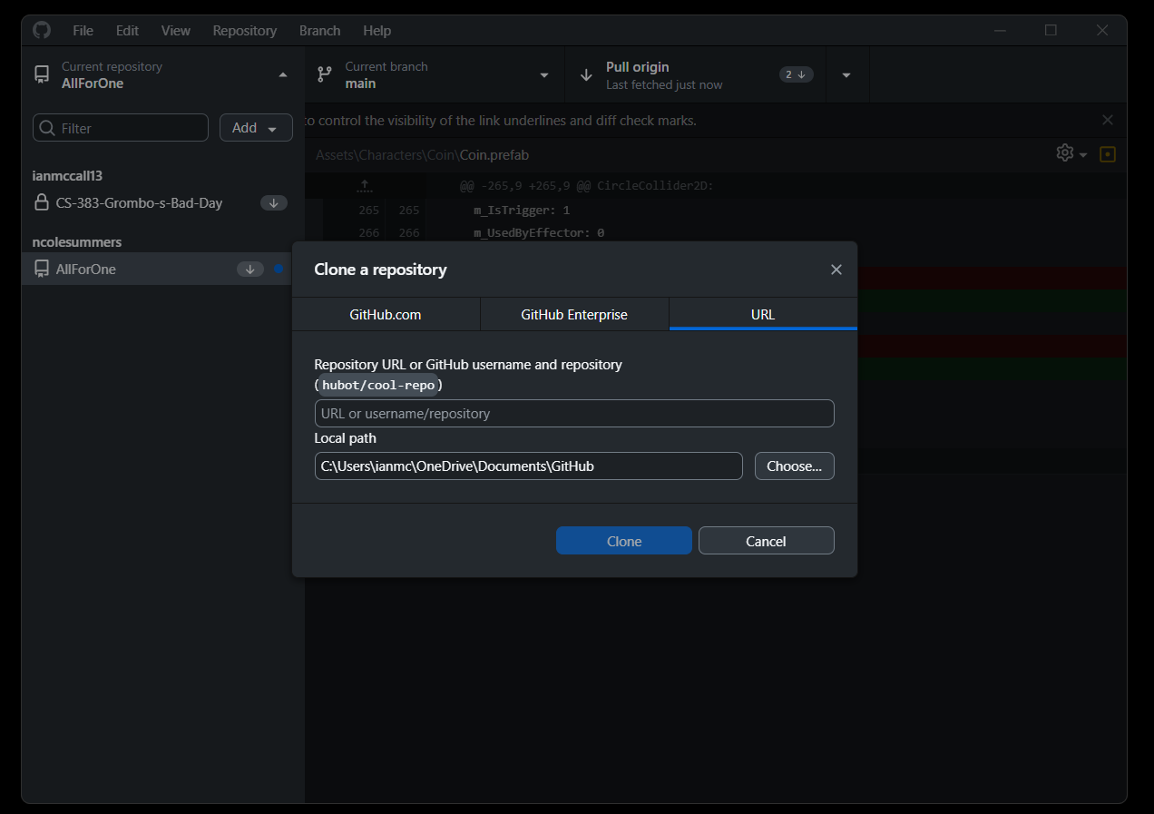
Clone the Repository
Paste URL
Ian McCall

Slide 35
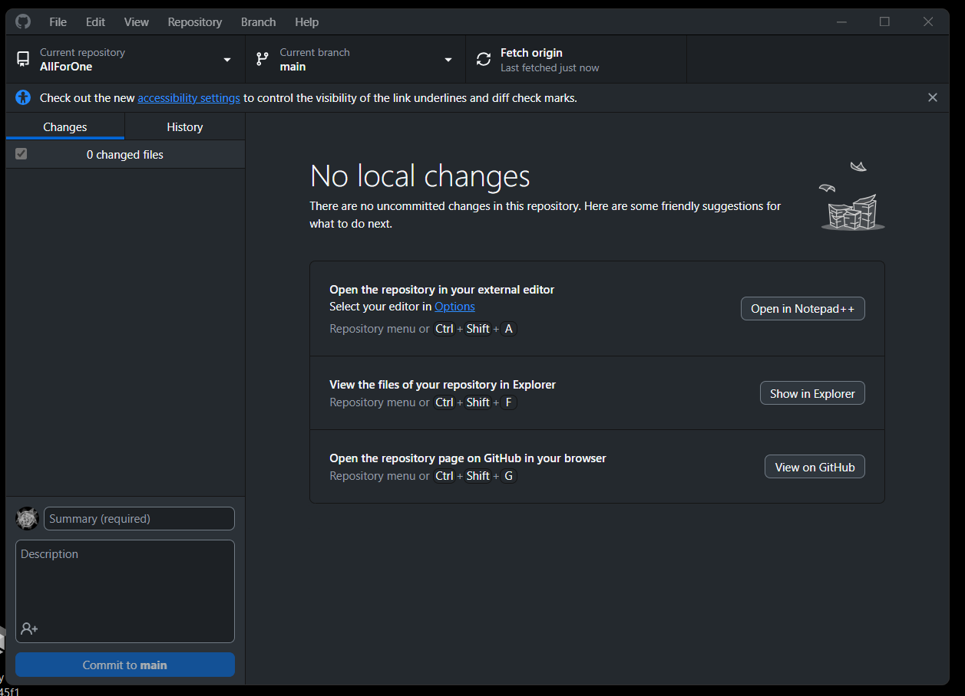
Fetch/Pull from Repository
Ian McCall

Slide 36
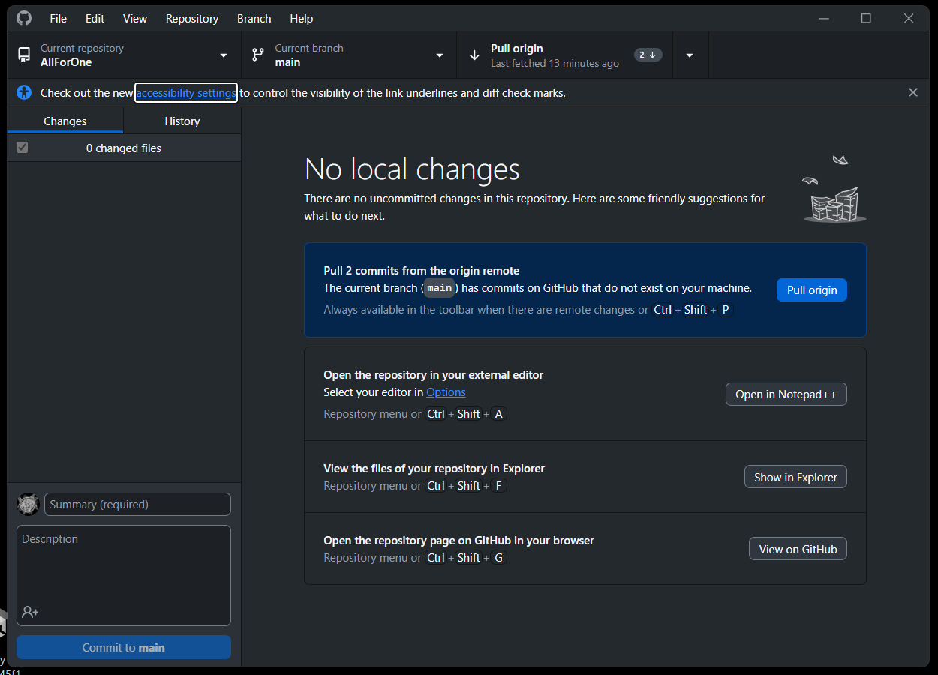
Fetch/Pull from Repository
Ian McCall

Slide 37
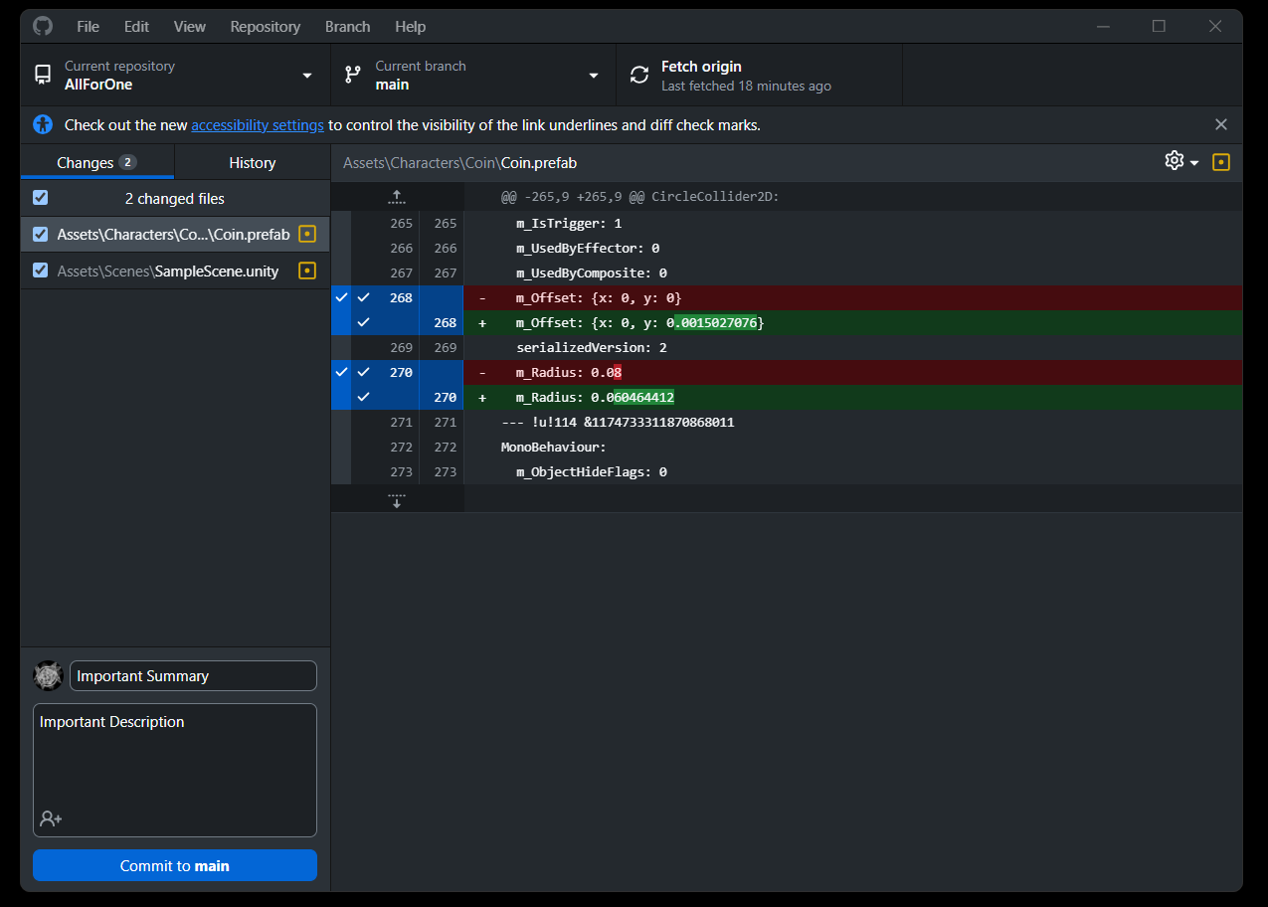
Pushing and Stashing
Ian McCall

Slide 38
Pushing and Stashing
Right Click and then click “Stash Changed Files”
Ian McCall

Slide 39
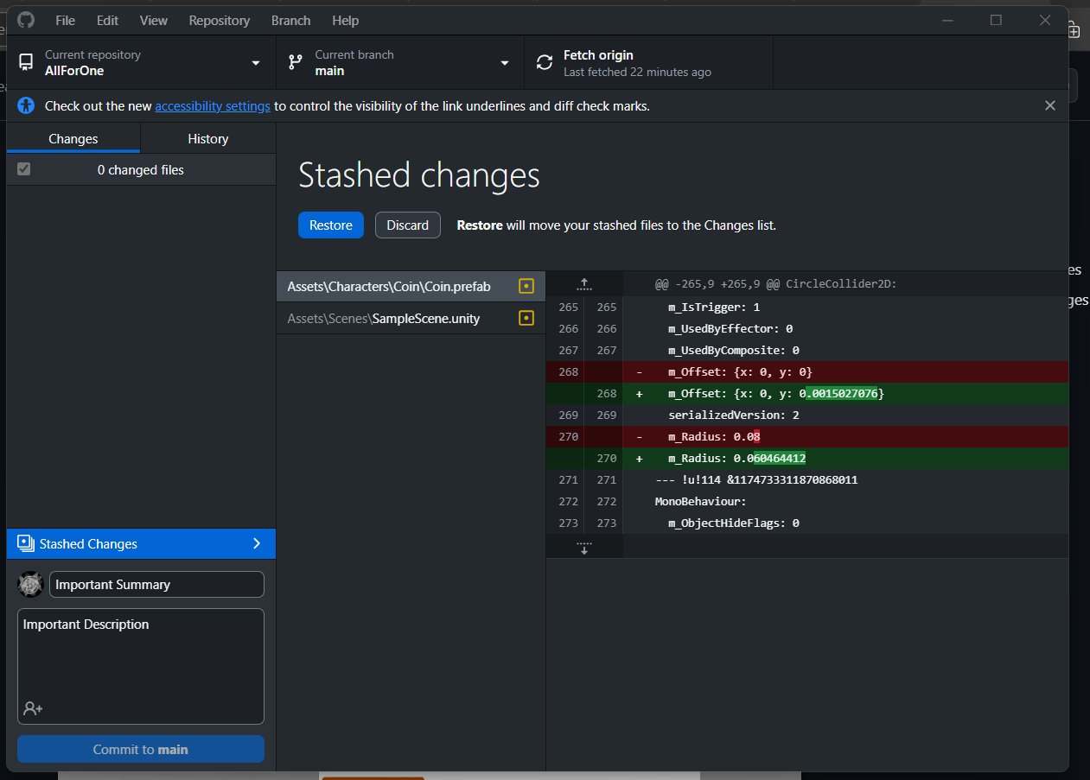
Pushing and Stashing
Ian McCall

Slide 40
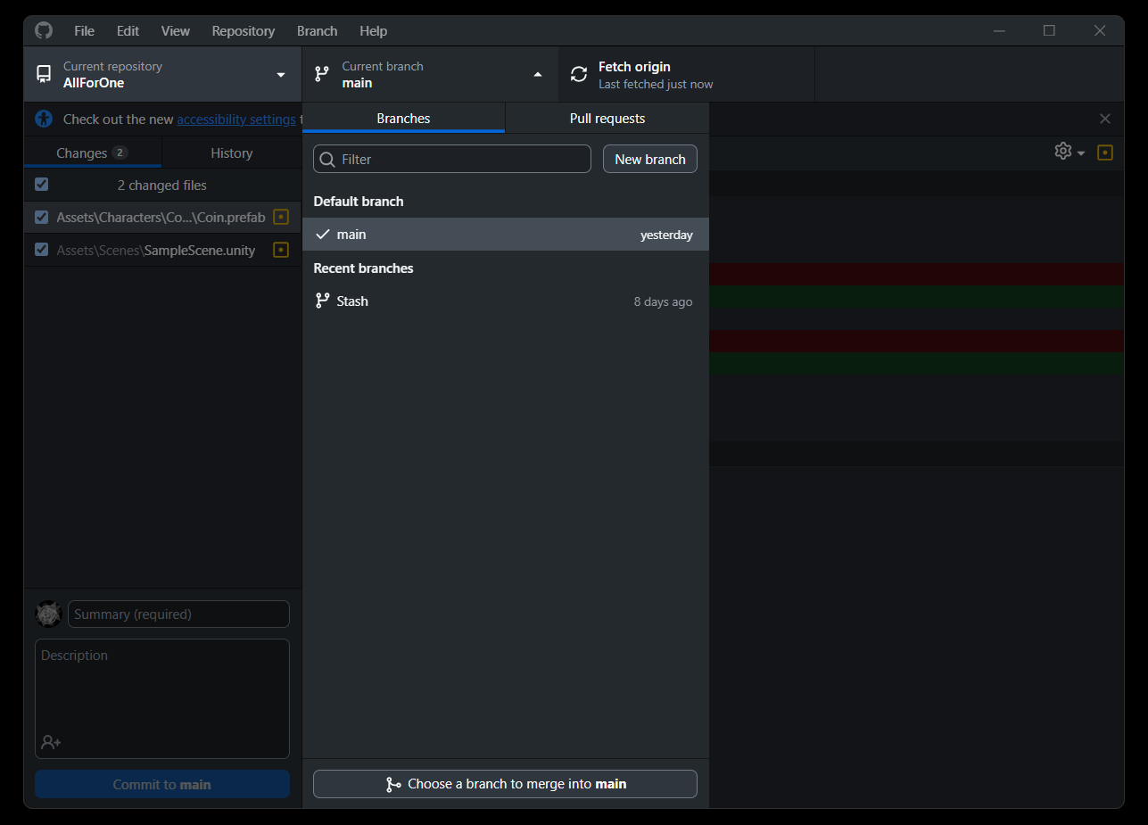
Merging Branches
Ian McCall

Slide 41
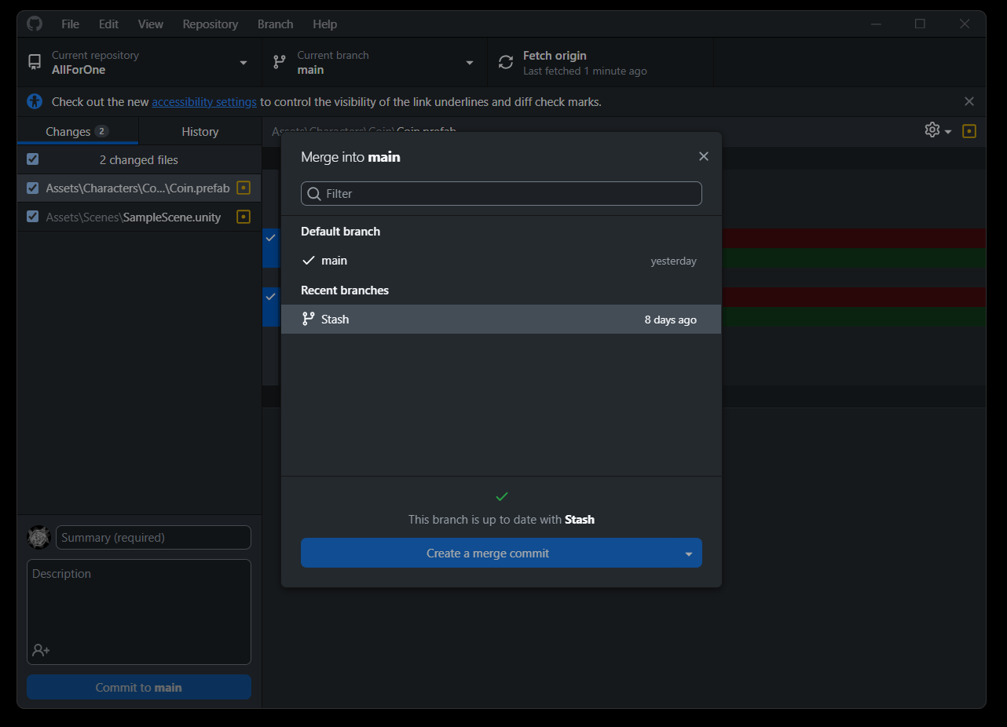
Merging Branches
Ian McCall

Slide 42
GITHUB Desktop Personally Recommended Order of Operations
Fetch/Pull from the Repository
Edit your Project
Stash your Changed Files
Fetch/Pull from the Repository
Restore your Stash to the Main Branch
Push and Commit your Changes
Ian McCall

Slide 43
Continuous Integration (CI)
A software development practice where team members frequently integrate their work into a shared repository, typically multiple times per day.
Key aspects:
Frequent code commits
Automated Builds
Automated Testing
Rapid feedback
Notes:
Intro:"Next, we're going to discuss Continuous Integration, or CI, a crucial practice in modern software development."
Definition:
"CI is all about integrating work frequently and consistently."
"Instead of working in isolation for long periods, developers share their work with the team multiple times a day."
"This 'little and often' approach helps catch issues early and keeps everyone on the same page."
“It’s the first and most important part of CI/CD or Continuous Integration and Continuous Delivery. CD is outside the scope of this tutorial.”
Key Aspects:
Frequent code commits:
"Developers push small changes regularly, often several times a day."
"This reduces the risk of merge conflicts and makes integration smoother."
Automated Builds:
"Every time code is committed, an automated system builds the entire application."
"This ensures that new changes don't break the build process."
Automated Testing:
"After each build, automated tests are run to check for bugs or regressions."
"This can include unit tests, integration tests, and sometimes even UI tests."
Rapid feedback:
"Developers get quick feedback on their changes."
"If something breaks, they know immediately and can fix it while it's still fresh in their minds."
Closing:
"These four aspects work together to create a more efficient, reliable development process."
“There are many ways to implement CI pipelines. In the following slides, we’ll be covering the most popular choice: GitHub Actions.”

Slide 44
Introducing GitHub Actions
GitHub’s built-in CI/CD platform.
Automates software workflows
Runs directly in your GitHub repository
Notes:
Opening statement: "Now that we understand the concept of CI/CD, let's dive into GitHub Actions, a powerful tool that allows you to create automated pipelines directly within your GitHub workflow."
Define GitHub Actions and introduce pipelines: "GitHub Actions is GitHub's built-in CI/CD platform. It enables you to create what we call 'pipelines' – automated sequences of tasks that handle various aspects of your software development process. These pipelines can include steps for building your code, running tests, and deploying your application, all triggered by events in your GitHub repository."
Key features:
"Flexibility: You can build custom pipelines that suit your project's specific needs."
"Community: There's a marketplace of pre-built actions you can incorporate into your pipelines, saving you time and effort."
How it works: "GitHub Actions works by listening for specific events in your repository, such as a push, pull request, or even a scheduled time. When an event occurs, it triggers your defined pipeline, which then executes a series of steps you've specified."
Benefits:
"Automation: Repetitive tasks in your development pipeline, like testing and deployment, can be automated, saving time and reducing human error."
"Consistency: Ensures that the same pipeline process is followed every time, regardless of who triggers it."
"Visibility: The status and logs of your pipeline runs are easily accessible right in your GitHub repo."
Game Development context: "For Game developers, this means you can create pipelines to automate tasks like running tests, building your game for different platforms, and even deploying builds to various destinations."
Transition to next topic: "In the next few slides, we'll delve deeper into how GitHub Actions works and how we can set up effective pipelines. But first, are there any questions about what GitHub Actions is, what we mean by pipelines, or their basic functionality?"

Slide 45
Key Components of GitHub Actions
Workflows: Automated processes you set up
Jobs: Sets of steps that execute on the same runner
Steps: Individual tasks that run commands
Actions: Standalone commands combined into steps
Notes:
Introduction: "Now that we've introduced GitHub Actions, let's break down its key components. Understanding these building blocks will help you create and manage effective CI/CD pipelines for your projects."
Workflows: "At the highest level, we have workflows. A workflow is an automated process that you set up in your repository."
"Think of a workflow as a recipe for your CI/CD pipeline."
"It defines when, where, and how your automation tasks should run."
"Workflows are defined using YAML files stored in your repository."
Jobs: "Within each workflow, we have jobs. A job is a set of steps that execute on the same runner."
"A runner is a server that runs your workflows."
"Jobs are the main building blocks of your workflow."
"For a Game Development project, you might have separate jobs for testing, building, and deploying."
"By default, jobs run in parallel, which can speed up your workflow."
Steps: "Jobs are made up of individual steps. Each step is a single task in your job."
"Steps run commands or use actions."
"They execute in order, one after another."
"For example, a step might be 'Install Unity', 'Run tests', or 'Build for Windows'."
Actions: "Finally, we have actions. An action is a standalone command that can be combined into steps to create a job."
"Think of actions as reusable units of code."
"GitHub provides many pre-built actions, and there's a marketplace full of community-created actions."
"For Unity, there are specific actions for setting up Unity, activating licenses, and building projects."
"You can also create your own custom actions if needed."
Summary: "So, to summarize: Your workflow is made up of one or more jobs. Each job consists of a series of steps. And each step can run commands or use actions."
Transition: "Now that we understand these components, in the next slides, we'll look at how to actually set up a workflow for a Unity project.

Slide 46
Considering Cost
Free tier for private repositories:
Basic: 2000 minutes per month
Pro: 3000 minutes per month
Pro is free with the GitHub Student Developer Pack (https://education.github.com/pack)
My average run time per Unity build: 27 minutes
Notes:
"Before we dive deeper into setting up our CI/CD pipeline, it's important to understand the cost implications of using GitHub Actions, especially for private repositories."
“We recommend private repositories to avoid licensing concerns.” “Moving to a public repository for free GitHub Actions is an inversion of priority. Avoiding legal troubles is more important than unlimited actions.”
“While integrating on every commit is the ideal, be realistic about how often you can afford automated testing. Nightly builds may be a better fit for a student project.”
“I’ll show a basic example of each type on workflow on the next page.”

Slide 47
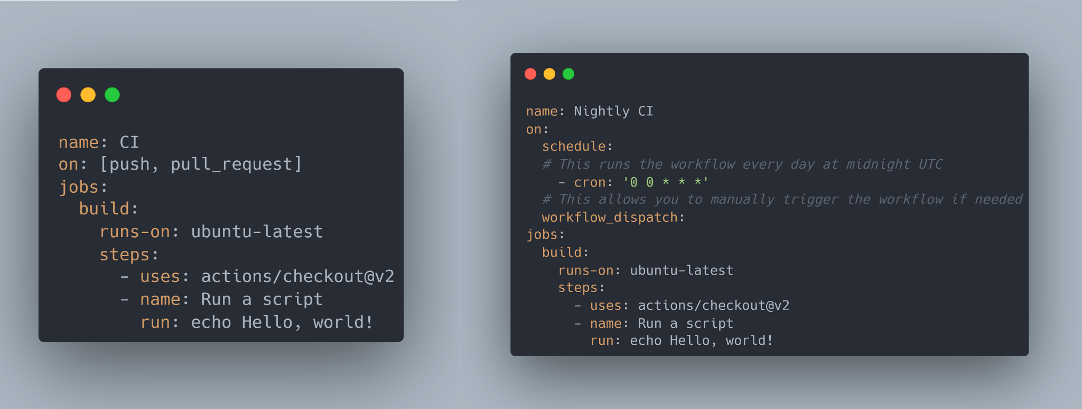
Hello, GitHub Actions!
Notes:
Left example:
This workflow is named "CI" and triggers on push and pull request events.
It has a single job called "build" that runs on the latest Ubuntu environment.
The job has two steps: checking out the code and running a simple "Hello, World!" script.
This represents a basic CI setup that runs for every code change.
Right example:
This workflow is named "Nightly CI" and runs on a schedule.
The cron syntax '0 0 * * *' means it runs every day at midnight UTC.
It also includes a manual trigger option with 'workflow_dispatch'.
The job structure is similar to the CI workflow, demonstrating consistency in workflow definitions.
Key points:
Workflows are defined in YAML format.
The 'on' field specifies when the workflow should run.
Jobs define what actions to take, including the environment and steps.
Steps can use pre-built actions (like 'actions/checkout@v2') or run custom commands.
Transition: "These examples show the flexibility of GitHub Actions. You can set up workflows to run on code changes, on a schedule, or even manually. In our Unity projects, we'll build on this basic structure to include Unity-specific actions and more complex build processes."

Slide 48
GitHub Actions for Unity
Challenge: Unity projects have unique requirements which make CI/CD complex:
Unity Installation
License Management
Platform-specific build processes
Solution: GameCI (https://game.ci)
Notes:
Introduction: "Now that we understand the basics of GitHub Actions, let's see how we can leverage this powerful tool specifically for Unity game development."
Unity-specific challenges: "Unity development presents unique challenges for CI/CD pipelines:
Unity installations are large and version-specific
Builds can be resource-intensive and time-consuming
We often need to build for multiple platforms
Unity requires a valid license for building"
Enter GameCI: "This is where GameCI comes in. GameCI provides a set of custom GitHub Actions tailored specifically for Unity projects."
Benefits of using GameCI:
"Automates Unity-specific tasks in your CI/CD pipeline"
"Handles Unity installation and licensing automatically"
"Supports building for multiple platforms in parallel"
"Integrates seamlessly with other GitHub Actions"
Example workflow structure: "A typical Unity workflow with GameCI might look like this:
Activate Unity license
Run tests
Build for multiple platforms
Return Unity license
Upload build artifacts"
Customization options: "GameCI actions are highly customizable. You can specify Unity versions, target platforms, build options, and more."
Resource considerations: "Remember, Unity builds can be resource-intensive. Be mindful of your GitHub Actions usage limits, especially for larger projects or frequent builds."
Conclusion: "By combining GitHub Actions with GameCI, we can create robust, automated pipelines for Unity development, streamlining our workflow from testing to multi-platform deployment."

Slide 49
Quick Start
Create a .github/workflows directory at the root of your repository
Grab the example pipeline from my GitHub gist (https://gist.github.com/ncolesummers)
Shove it in the Repository
Stage
Commit
Push
Notes:
Introduction: "Now that we understand the basics of GitHub Actions and its application to Unity projects, let's go through a quick start guide to set up your first workflow."
Explain GitHub Gist: "Before we dive into the steps, let me quickly explain what a GitHub gist is. A gist is a simple way to share snippets of code or other pieces of text. It's like a miniature repository hosted by GitHub. In this case, I've created a gist with an example pipeline that you can easily copy and use in your own projects."
Walk through:
"First, create a .github/workflows directory at the root of your repository. This is where GitHub looks for workflow files."
"Next, you'll want to grab the example pipeline from my GitHub gist. The link is my gists on GitHub. There is only one gist. This gist contains a pre-configured workflow file tailored for Unity projects."
"Once you've copied the contents of the gist, simply paste it into a new file in the .github/workflows directory you just created. You might want to name it something like 'unity-ci.yml'."
"After creating the file, you'll need to stage it. This means telling Git that you want to include this new file in your next commit."
"Now, commit the changes. This creates a snapshot of your repository with the new workflow file included."
"Finally, push your changes to GitHub. This uploads your new commit, including the workflow file, to your remote repository."
Next: "Once you've pushed these changes, GitHub will automatically detect the new workflow file and start running it according to the triggers you've defined. In this case, it will likely run on every push to your repository."
Customization note: "Remember, this is just a starting point. You may need to customize the workflow to fit your specific project needs, such as specifying the correct Unity version or adjusting build targets."
Transition: "In the next section, we'll take a closer look at what's actually in this workflow file and how you can modify it. But first, are there any questions about this quick start process?"

Slide 50
Find your Unity License
Use your existing Unity license file (.ulf)
Windows: C:\ProgramData\Unity\Unity_lic.ulf
Mac: /Library/Application Support/Unity/Unity_lic.ulf
Linux: ~/.local/share/unity3d/Unity/Unity_lic.ulf
Troubleshooting:
Ensure you're logged into Unity Hub
Verify your license is activated
Check for hidden folders if file isn't visible
Add license as a GitHub secret:
Name: UNITY_LICENSE
Value: Contents of your .ulf file
Notes:
"Setting up your Unity license correctly is crucial for your GitHub Actions workflow. It allows the virtual environment to authenticate with Unity and perform builds and tests seamlessly."
"We're going to use our existing Unity license, which simplifies the process and ensures we're compliant with Unity's terms of service."
"Depending on your operating system, you'll find your Unity license file, which has a .ulf extension, in different locations."
"Don't worry about the security of this information. GitHub encrypts these secrets and only exposes them to your specified GitHub Actions workflows."
"Does anyone have any questions about locating their Unity license or adding it to GitHub?"

Slide 51
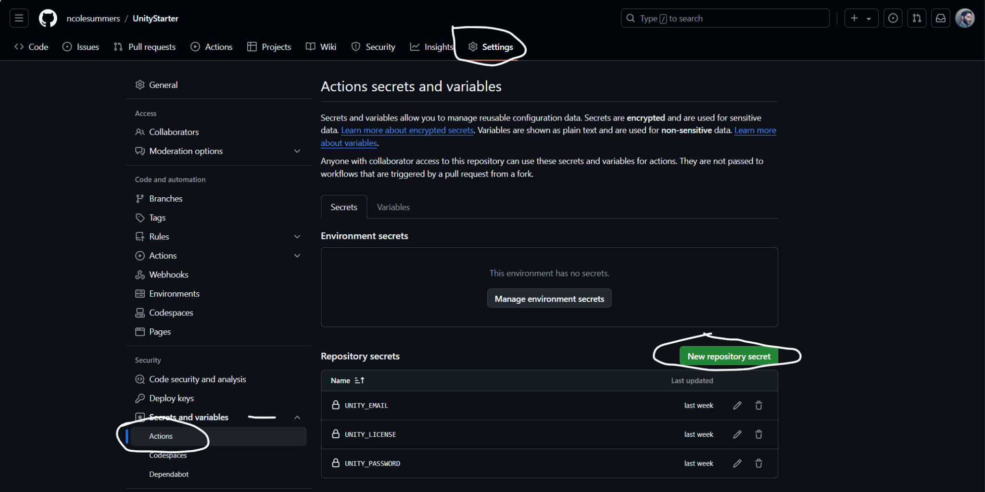
GitHub Secrets
Notes:
"Now, let's set up the necessary secrets for our Unity project in GitHub Actions:
1. First, navigate to your repository's 'Settings' tab, as highlighted at the top of the screenshot.
2. In the left sidebar, under 'Security', click on 'Secrets and variables', then select 'Actions'.
3. You'll see a 'New repository secret' button in the bottom right. Click this to add each secret.
4. We need to add three secrets for our Unity workflow:
- UNITY_EMAIL: Your Unity account email
- UNITY_LICENSE: The contents of your Unity license file - covered in the next slide
- UNITY_PASSWORD: Your Unity account password
5. For each secret, click 'New repository secret', enter the name in all caps, paste the value, and click 'Add secret'.
6. Once added, you'll see all three secrets listed as shown in the screenshot.
Remember, these secrets are encrypted and only exposed to selected actions in your workflow, ensuring the security of your sensitive information."
This script provides a clear, step-by-step guide that matches the visual information in the screenshot. It covers the process of navigating to the correct page, adding each secret, and reassures the audience about the security of their information.

